Slide 1
NYPD Shooting Incident Data Analysis
Presenter: Shaelyn XinYue Zheng

Slide 2

Project analysis slide 2
Introduction
New York City – A very attractive travel destination for many Canadians
Safety is one of the most important concerns
Would be interesting for travelers to know where and when is safe to stay and go to New York City

Slide 3

Project analysis slide 2
Description of the Data
NYPD Shooting Incident Data (Historic)
Source: https://catalog.data.gov/dataset
Include every shooting incident that occurred in NYC from 2006 -2021
Data manually extracted every quarter and reviewed by the Office of Management Analysis and Planning before being posted on the NYPD website.
Data includes information about the shooting events, location, time of occurrence, information related to the suspect, and victim demographics.

Slide 4
Project analysis slide 2
Analysis topics
Which area in NYC is safer?
When would be safer to travel to NYC?
Number of shooting incidents in Time sequence
Analysis of the number of victims by Boros. Find a relatively safer place with fewer shootings occurring.
Analysis of the number of victims by gender
for the year 2021. Find suggested time for travel planning.
Build a data model to predict the number of total victims in the time sequence of the years.

Slide 5
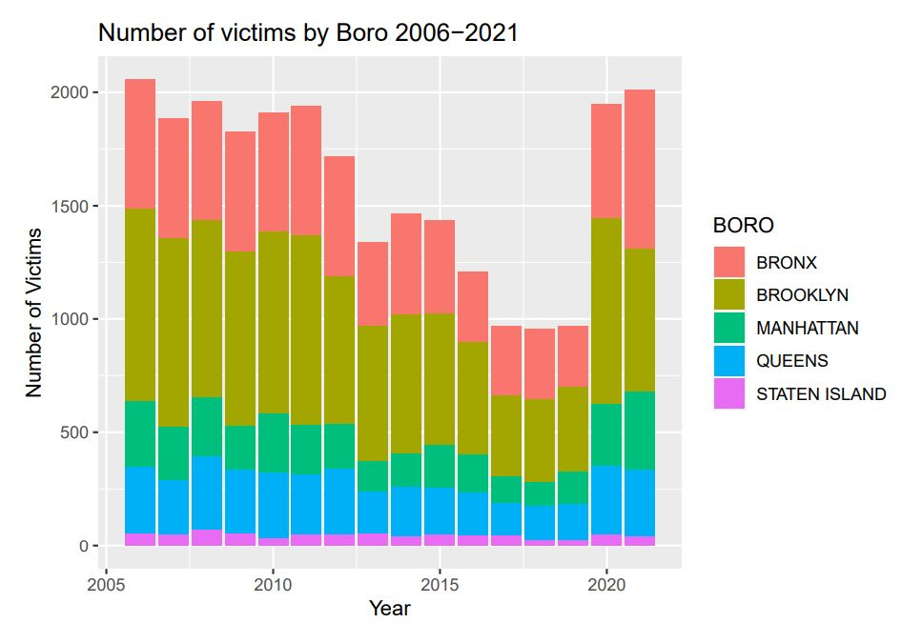
Project analysis slide 2
Analysis case 1
Observations
The Total number of victims reached its minimum in 2017, 2018, and 2019.
Brooklyn has the most number of victims, followed by Bronx.
Staten Island has the least total victims from 2006-2021.
Manhattan and Queens Boros have a relatively close number of total victims for each of them, with Queens slightly higher than Manhattan.
Conclusions
I would suggest avoiding the area of Brooklyn and Bronx.

Slide 6
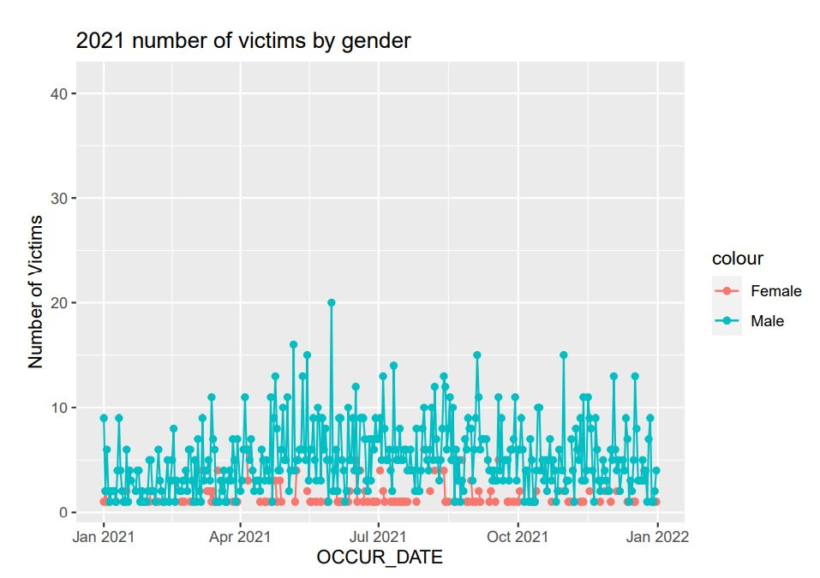
Project analysis slide 2
Analysis case 2
Observations
Males being a victim is larger than Females.
Almost every single day during the year 2021, there are Males being victims of a crime, but not Females.
More Female victims are observed from approximately June to August and late September to early October
The day with the highest number of Male victims occurred in May.
Conclusions
Males are relatively safer from January – April.
Females should avoid June to August and late September to early October.

Slide 7
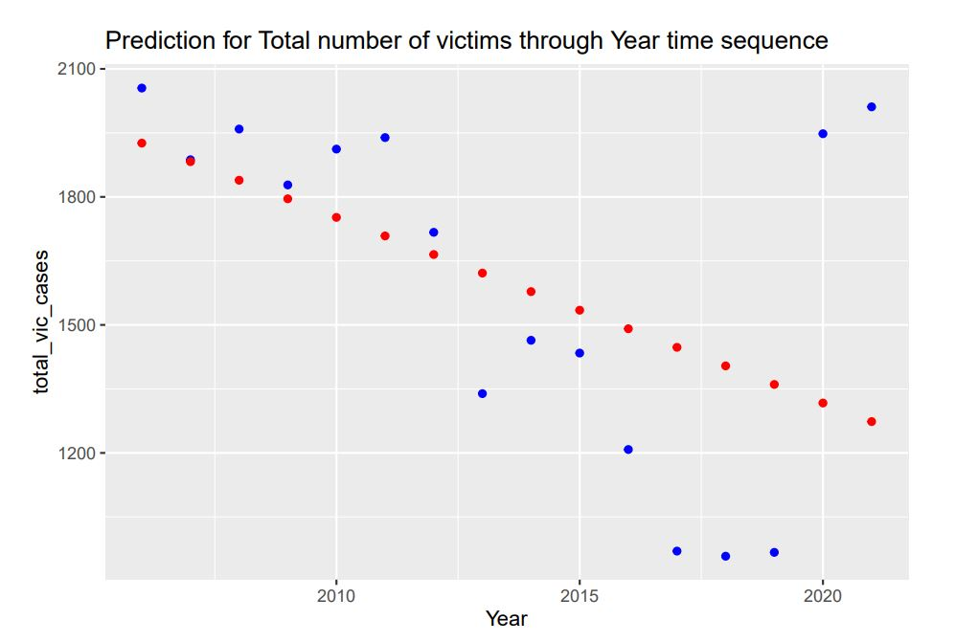
Project analysis slide 2
Build a Data Model
Number of shooting incidents in Time sequence
A data model to predict the number of total victims in the time sequence of the years.

Slide 8
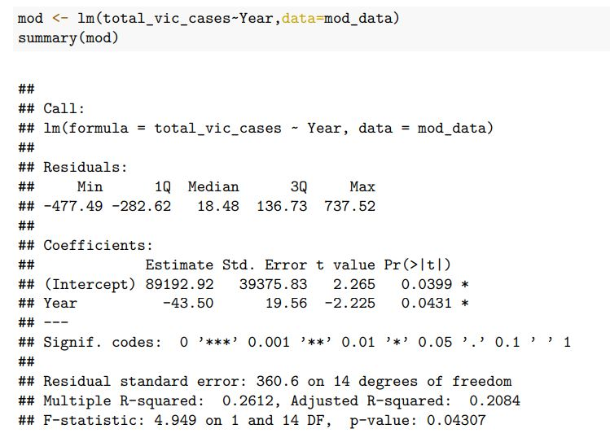
Project analysis slide 2
Build a Data Model

Slide 9
Project analysis slide 2
Bias Identification
For my analysis, I think the bias would come from the data source level.
Missing data in the fields, unspecified information detected.
Uncertainty when reading and processing the data, would and possibly reach biased output for analyzing topics.

Slide 10
Thank You

